Slide 1
Unsupervised Learning
Michelle Ho, Moon Jo, Ross Oglesby

Slide 2
Supervised vs. Unsupervised Learning
Supervised Learning:
Typically modeling a set of p features measured on n observations and response Y as measured by those observations.
Unsupervised Learning
A set of statistical tools reserved for the setting where we only have a set of features measured on n observations.
Goal is to discover interesting things about the data, rather than predict Y.

Slide 3
Principal Component Analysis

Slide 4
PCA: Conceptual Overview
Conceptually, PCA finds a low dimensional representation of a data set that contains as much of the variation as possible.
Mathematically, it involves normalizing the data around the factors mean, creating a correlation matrix between all the factors, calculating the corresponding eigenvectors and eigenvalues from the correlation matrix and finding the principal component (largest eigenvector) and corresponding loadings (eigenvalues)

Slide 5
PCA-A Step by Step Example
Now subtract the mean of each column to normalize the data. This produces a data set of mean 0.
Consider Matrix X:
X | Y
1.2 | 14
2.5 | 18
3.7 | 22
4.5 | 33
9.8 | 7
X | Y
-3.14 | -4.8
-1.84 | -0.8
-0.64 | 3.2
0.16 | 14.2
5.46 | -11.8

Slide 6
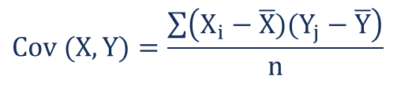
PCA-A Step by Step Example
Now! We calculate the corresponding Eigenvalues and Eigenvectors for the covariance matrix:
Eigenvalues:
Eigenvectors:
Now Calculate the Covariance Matrix! Remember, Covariance is calculated as:
Thus our Covariance matrix will be 2x2:
95.37
9.193
-0.139 | -0.990
0.990 | -0.139
Cov(X,X)=10.873 | COV(X,Y)=-11.915
COV(Y,X)=-11.915 | COV(Y,Y)=93.7

Slide 7
PCA-A Step by Step Example
We refer to the largest eigenvalue as the first principle component.
Principal Component: 95.37
The Corresponding Eigenvector is:
This corresponds to the vector that points down the “middle” of the data set and has the most significant relationship amongst the data.
-0.139
0.990

Slide 8
Tree-Based Method Hierarchical Clustering-Michelle

Slide 9
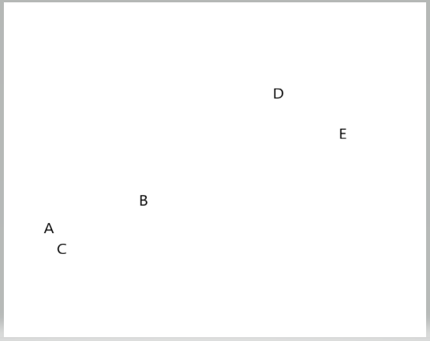
Hierarchical Clustering: Exercise

Slide 10
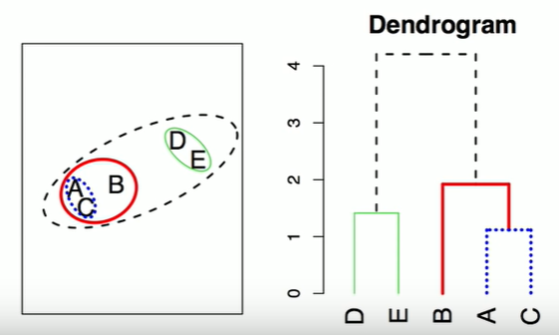
Hierarchical Clustering: Exercise

Slide 11
Tree Based Methods- Hierarchical Clustering
Ways to access data
Bottom-up (agglomerative clustering) VS Top-down
Linkage – (How to Connect Two Clusters) – 4 types
Dissimilarity Measures – (What to Connect Two Clusters) – 2 choices

Slide 12
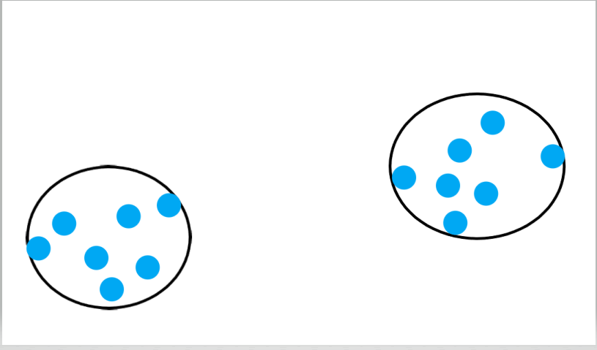
Hierarchical Clustering - How to Connect Clusters
Complete
Single
Centroid
Average

Slide 13
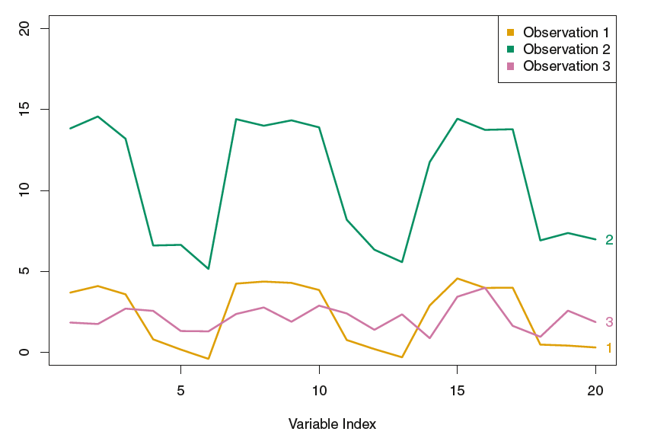
H-Clustering: What to Connect Two Clusters Euclidean vs Correlation-Based Distance

Slide 14
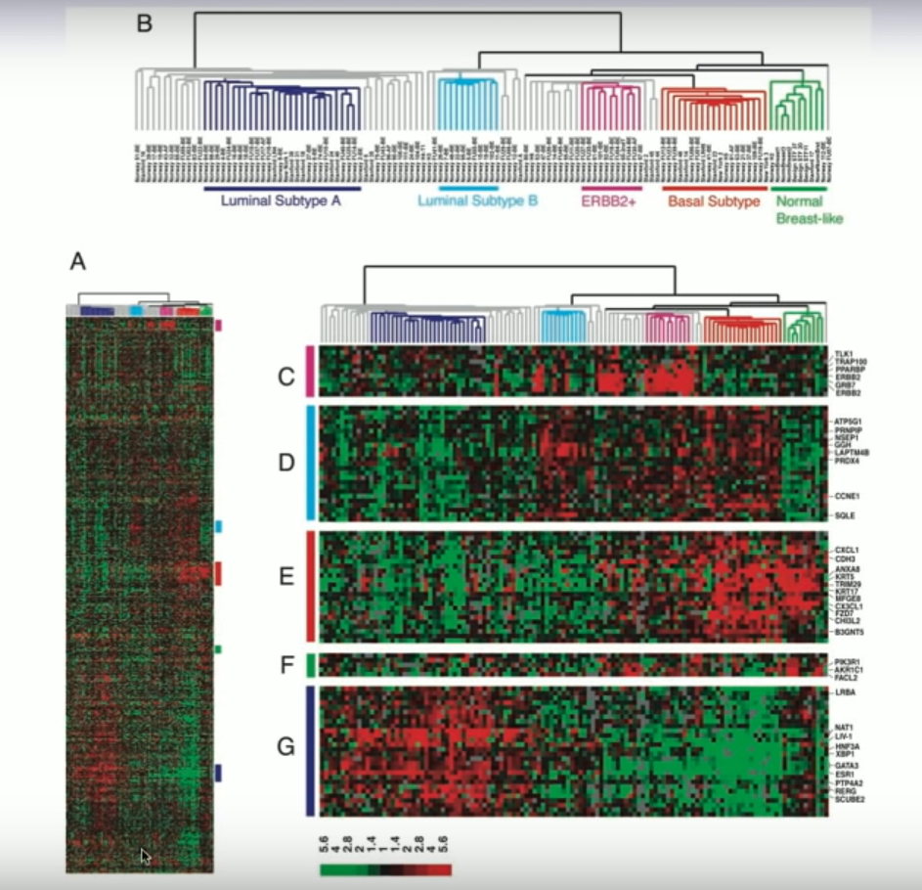
H-Clustering Application: Dendrogram + Heatmap

Slide 15
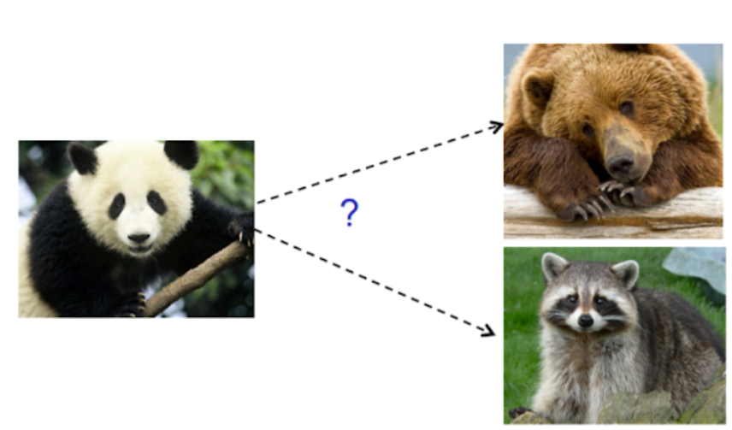
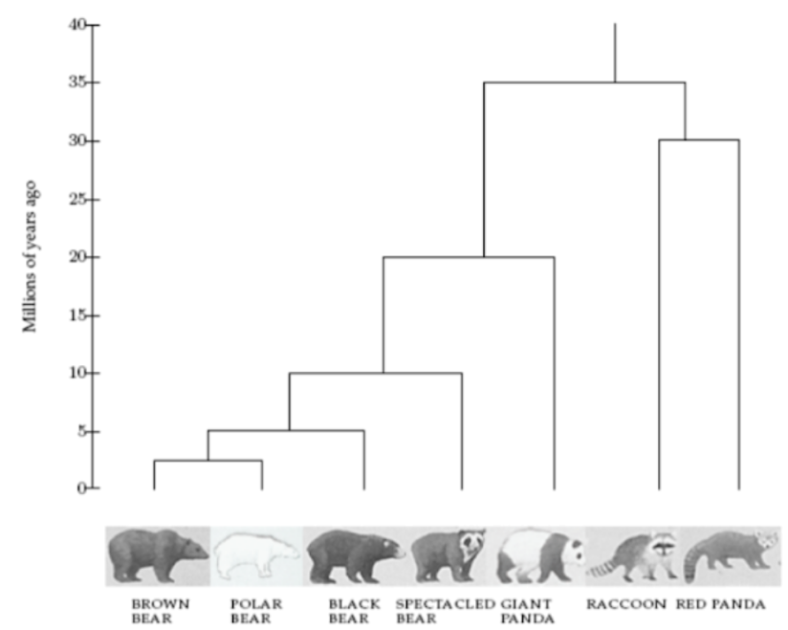
H-Clustering Application: Giant Pandas Closer to Bears or Racoons
https://towardsdatascience.com/hierarchical-clustering-and-its-applications-41c1ad4441a6

Slide 16
K Means Clustering - Moon

Slide 17
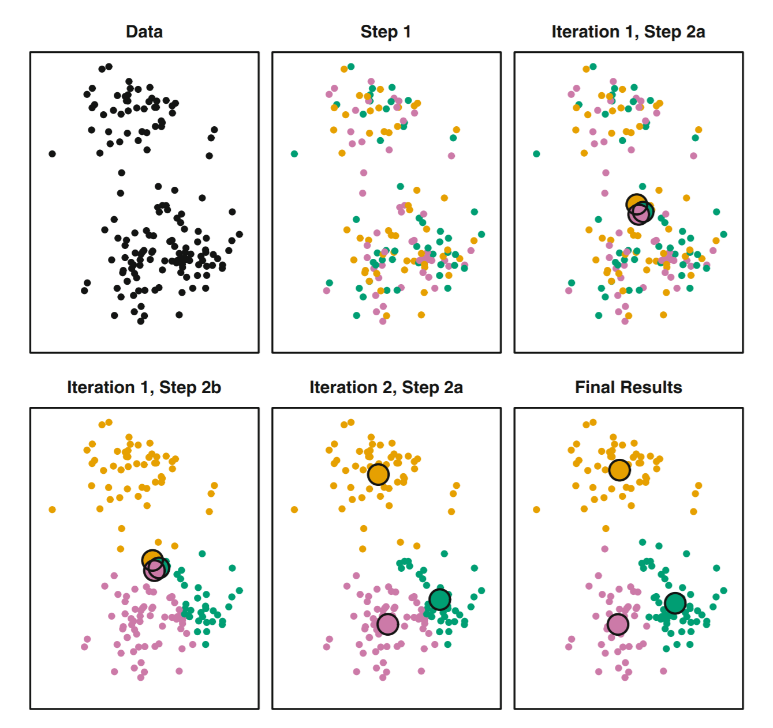
Decide on an arbitrary number of clusters (K)
Assign random #s, 1 to K, to every point
Compute the cluster centroid by taking the mean of all features in each cluster (e.g. on an x/y plot, mean x & mean y)
Assign each point to the centroid it’s closest to
Repeat steps 3 and 4 until the assignments to clusters for points don’t change

Slide 18
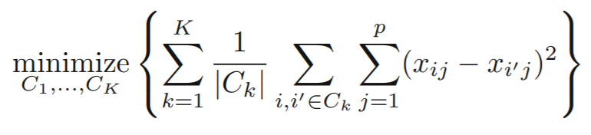
Math
i’ = observation following i
C_{k} = number of observations in the kth cluster
p = number of features

Slide 19
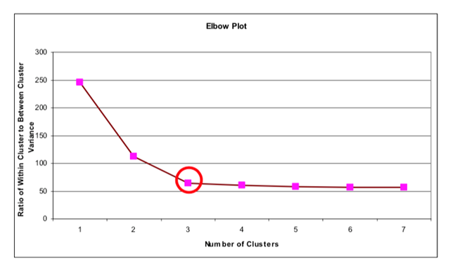
Notes
Every point is assigned to a cluster
Best solution minimizes total euclidian distance between points within clusters (variation), and maximize the distance between the centroids
Try different initial assignments and number of clusters
More clusters = less variance

Slide 20
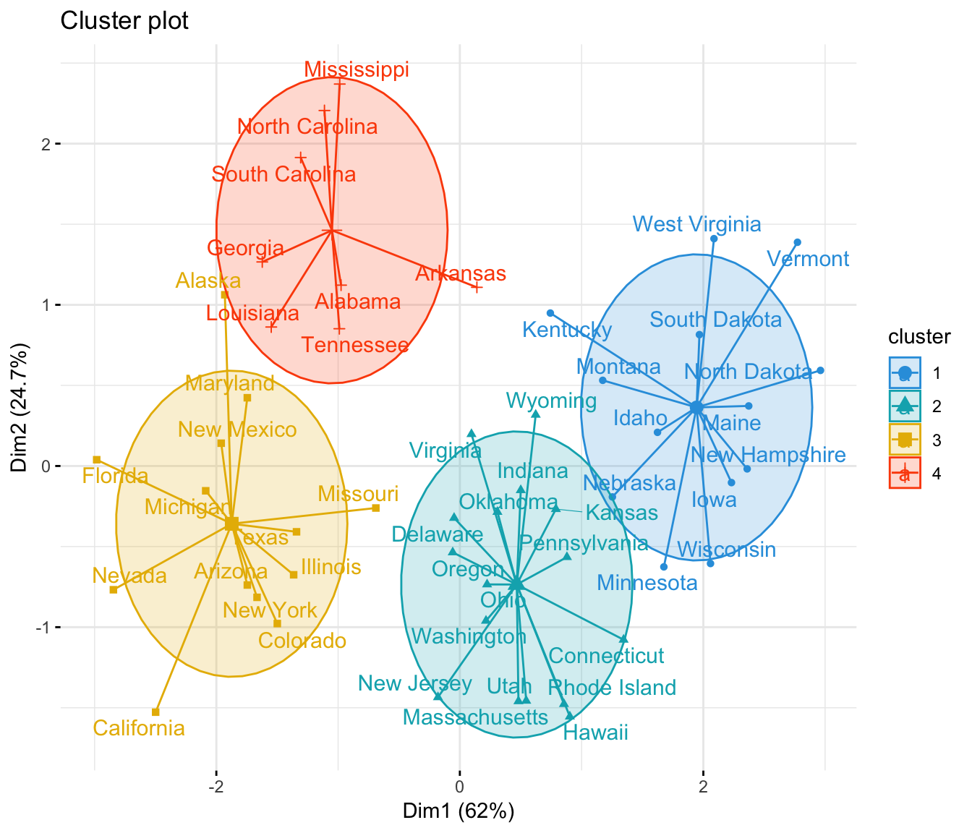
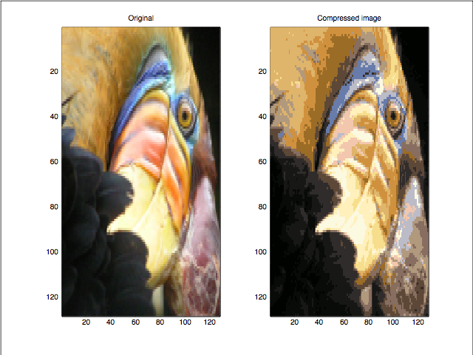
Examples
Apply after PCA
Group observations by distance
Apply labels
Image compression
Reduce file size
Plot color values, find clusters
Cost of quality

Slide 21
Questions???
Thank You ☺

Slide 22
Appendix

Slide 23
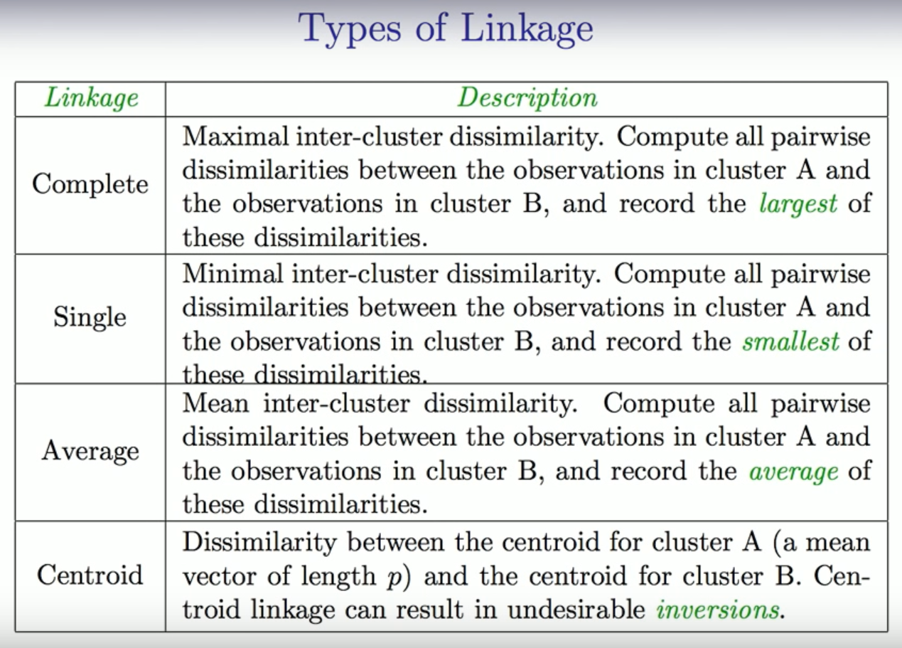
Hierarchical Clustering - How to Connect Clusters

Slide 24
References:
Hierarchical Clustering:
https://cran.r-project.org/web/packages/dendextend/vignettes/Cluster_Analysis.html
https://jcoliver.github.io/learn-r/008-ggplot-dendrograms-and-heatmaps.html
https://towardsdatascience.com/hierarchical-clustering-and-its-applications-41c1ad4441a6
K-means:
https://www.datanovia.com/en/lessons/k-means-clustering-in-r-algorith-and-practical-examples/
https://medium.com/@agarwalvibhor84/image-compression-using-k-means-clustering-8c0ec055103f

